Slide 1


Slide 2
85%
Nick Heudecker‏ (Gartner analyst)

Slide 3
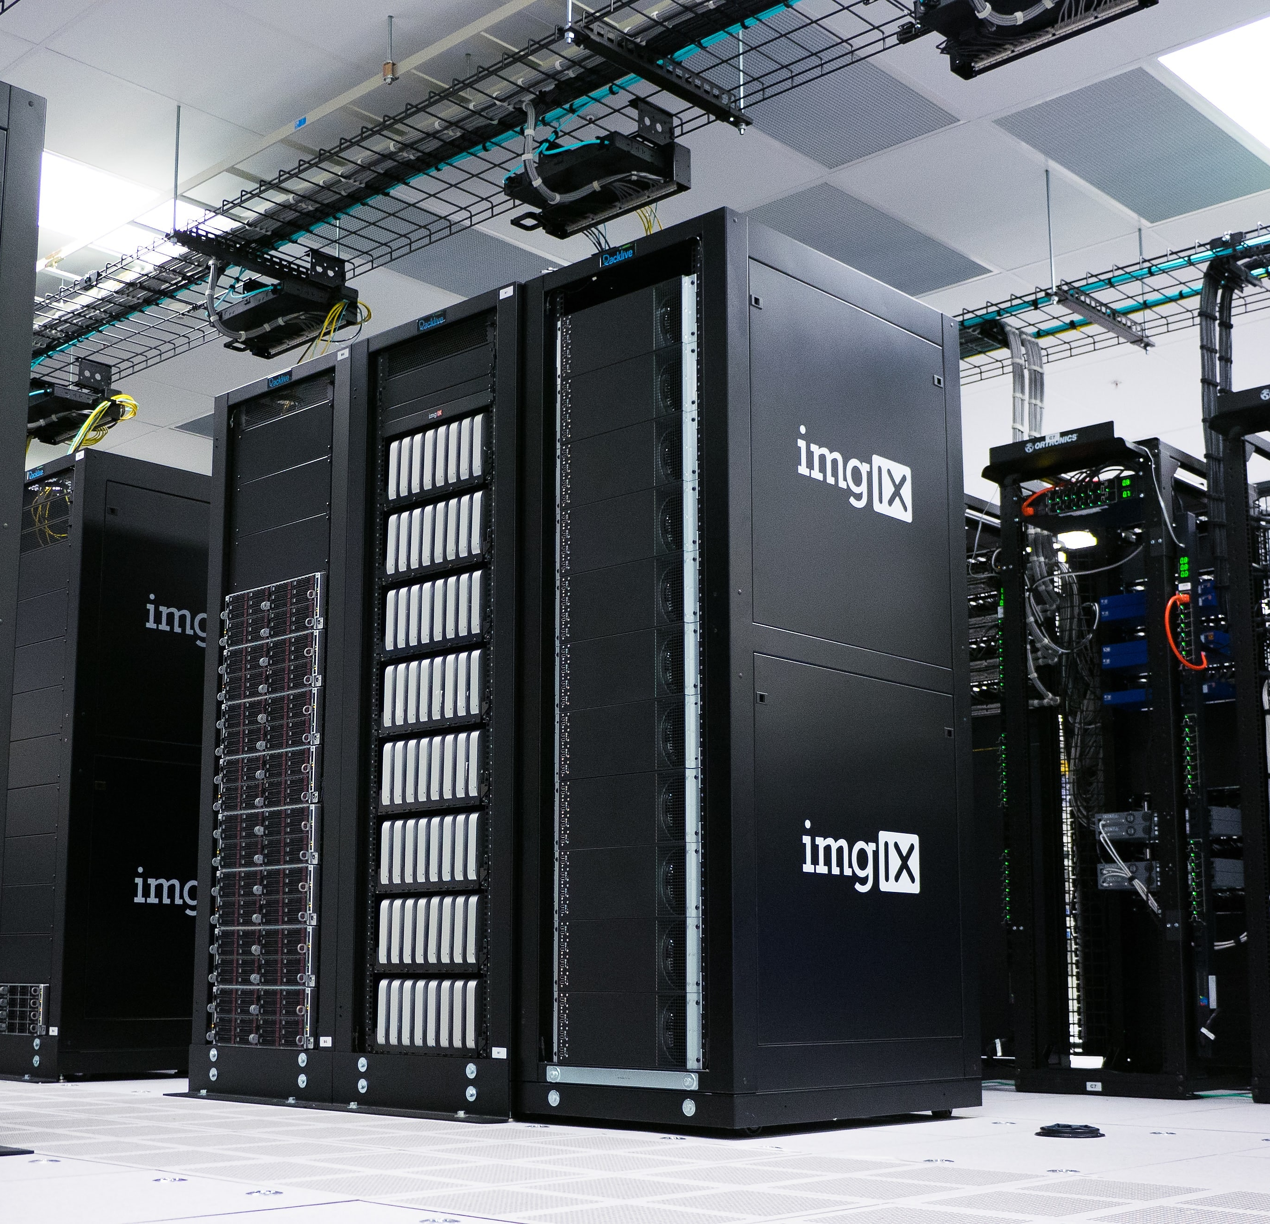


Slide 4
Getting your R Project into Production using Databricks

Slide 5
Data Science Lifecycle
Notes:
CRISP-DM
Team Data Science Process

Slide 6
Problem
Problem
Acquire Data
Model
Deployment

Slide 7



Slide 8


MapReduce
2004
2003
Google File System (GFS)
Predecessor to HDFS
History of Azure Databricks

Slide 9


MapReduce
Spark
2004
2012
2003
2006
Google File System (GFS)
Apache Hadoop Project
Predecessor to HDFS
History of Azure Databricks

Slide 10




DataFrames API / SQL
Streaming
Graph
Machine Learning

Slide 11
MapReduce
Spark
2004
2012
2003
2006
2013
Google File System (GFS)
Apache Hadoop Project
Databricks
Predecessor to HDFS
History of Azure Databricks

Slide 12
Architecture
Notes:
CRISP-DM
Team Data Science Process

Slide 13
Resilient Distributed Datasets
Directed Acyclic Graph

Slide 14
Resilient Distributed Datasets
Directed Acyclic Graph

Slide 15
Language APIs
Java, Scala, Python
SparkR
ML Pipelines
Spark ML
Analysis APIs
SQL
Dataframes
Datasets
ML lib
Spark SQL
Streaming
Graph
Resilient Distributed Datasets (RDDs)
Core API
Spark Core
https://databricks.com/blog/2016/12/28/10-things-i-wish-i-knew-before-using-apache-sparkr.html

Slide 16
Worker
Executor
Driver
Worker
Cluster Manager
Data sources
Spark Context
Executor
Worker
Executor

Slide 17
Databricks

Slide 18


Implementation

Slide 19



One Environment for the Whole Team

Slide 20

One Click Setup

Slide 21

Scale

Slide 22

Security

Slide 23
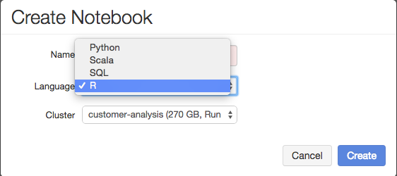
Interactive Notebooks

Slide 24

R Studio Integration

